Slide 1
SQL DataBase
HOW TO CREATE SQL DATABASE

Slide 2
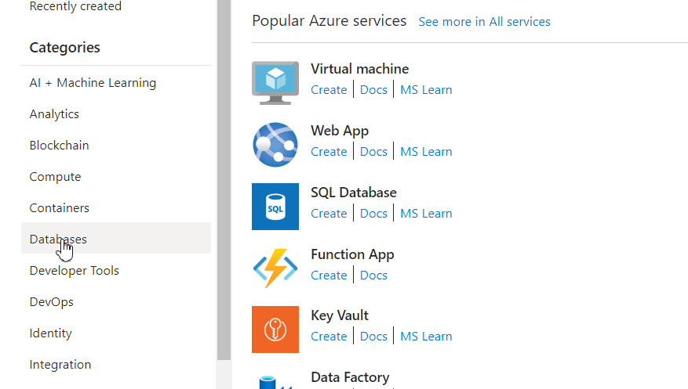
Select Databases

Slide 3
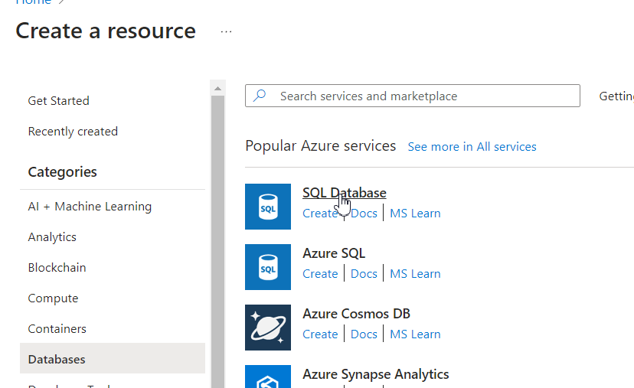
SQL Database

Slide 4
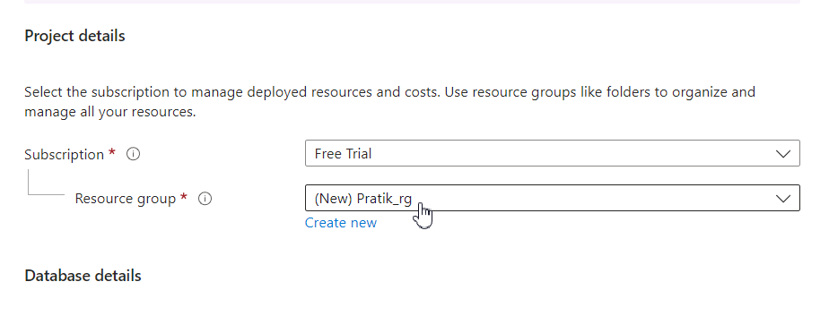
Create Resource Group

Slide 5
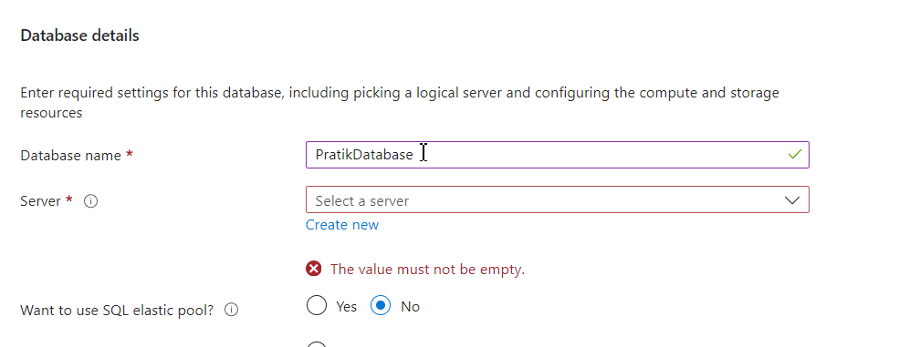
Enter Database Name

Slide 6
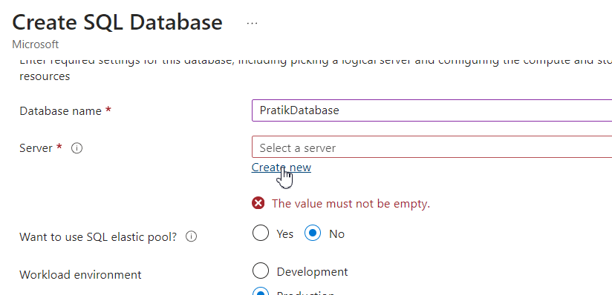
Create New Server

Slide 7
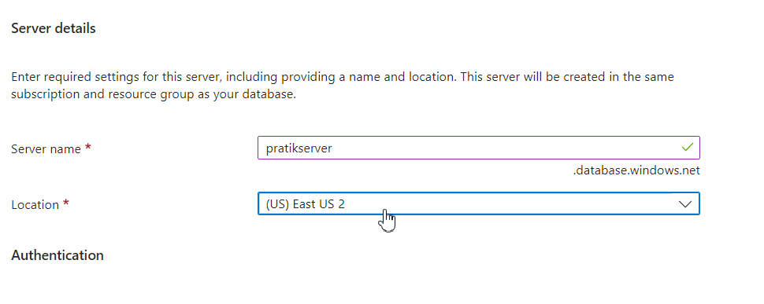
Select Server Location

Slide 8
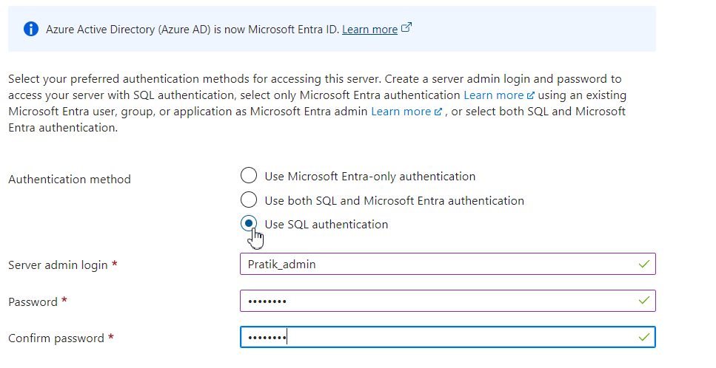
Authentication Method

Slide 9
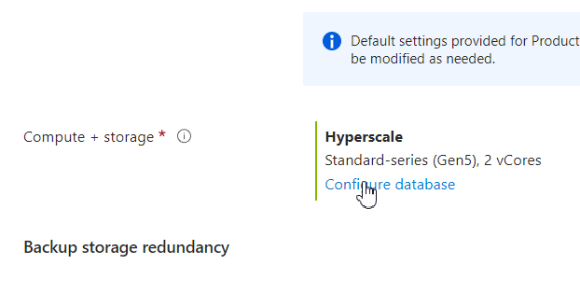
Configure Database Budget (IMPORTANT)

Slide 10
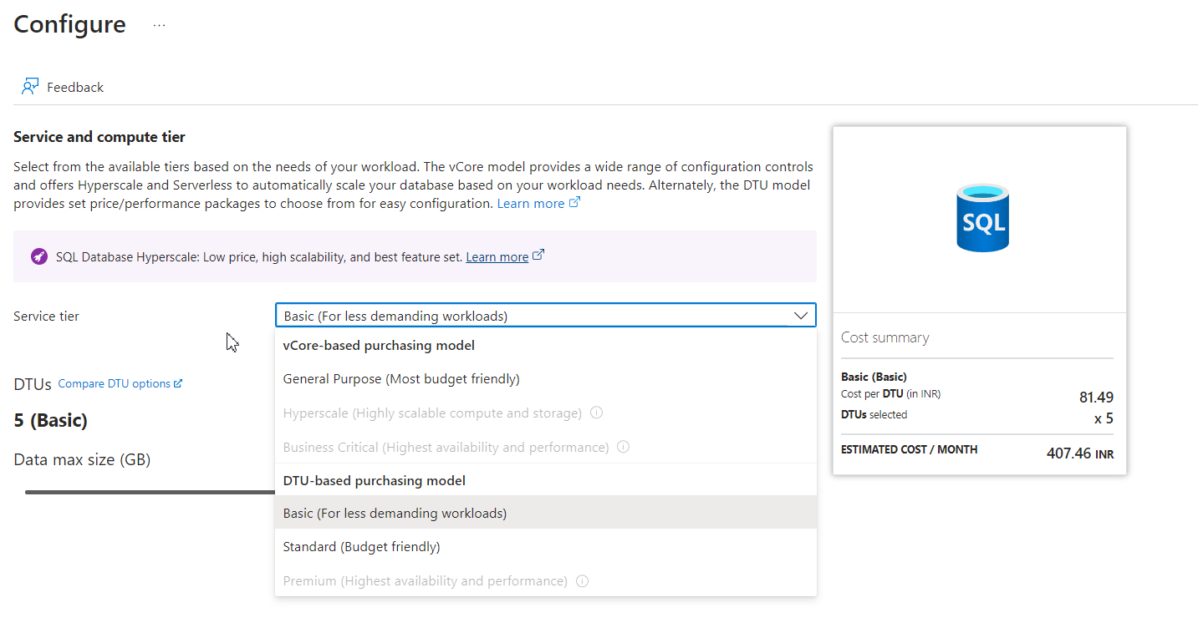
Configure according to Req. & Budget

Slide 11
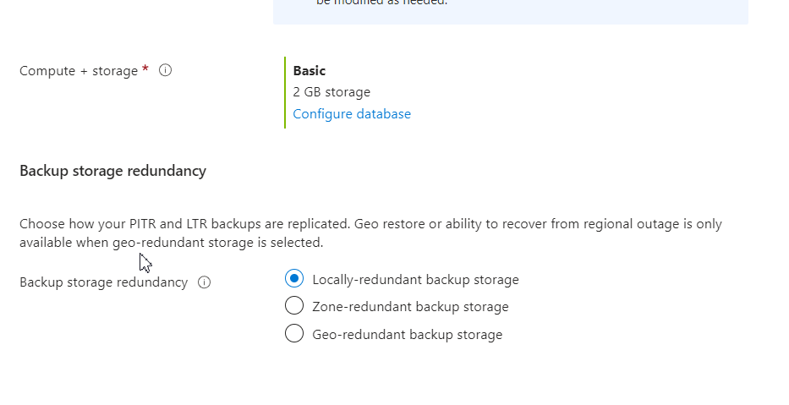
Redundancy

Slide 12
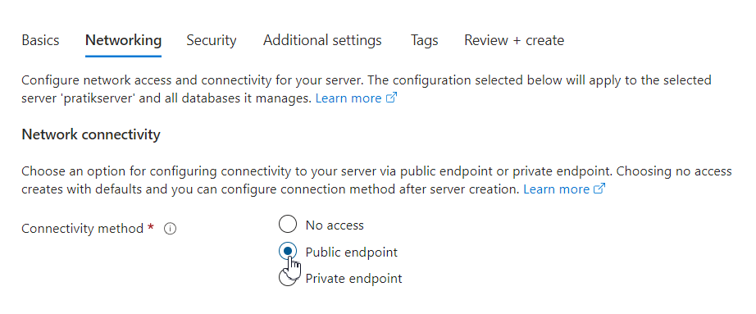
Network Connectivity : Public endpoint

Slide 13
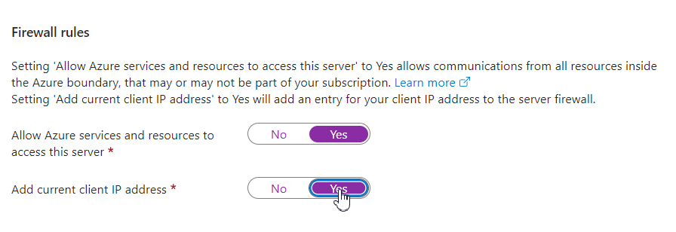
Firewall Rules

Slide 14
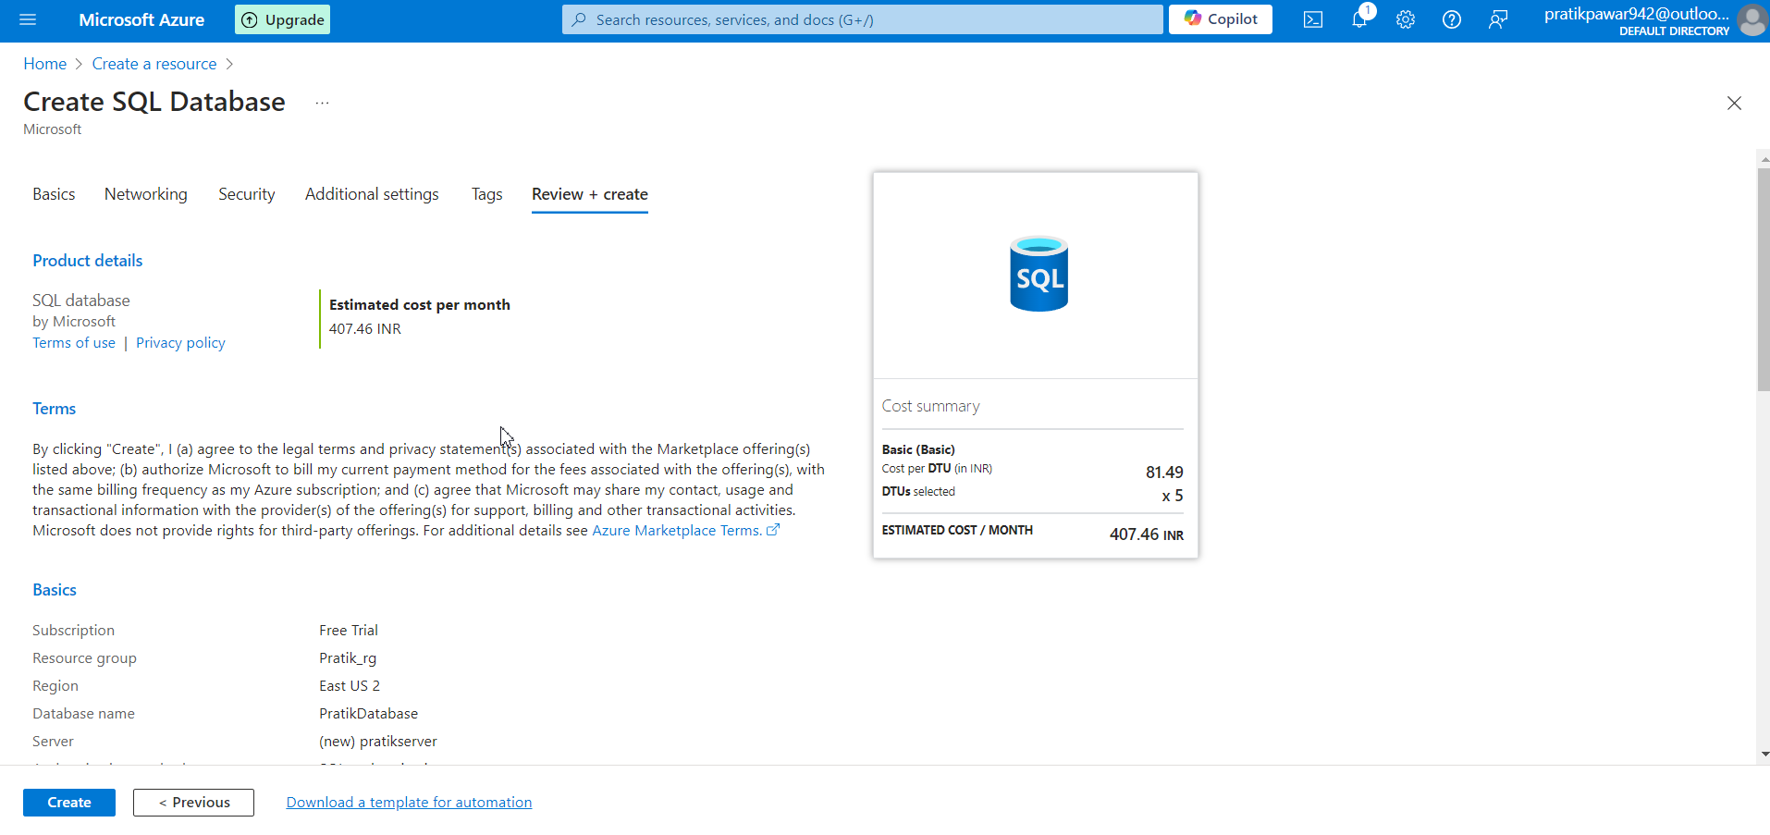
Make Changes according to need in Security and Additional Settings and Create it

